Slide 1

QALA EXPRESS LLC
Company profile

Slide 2

Introduction
Qala Express introduces full range of transportation and logistic service throughout Azerbaijan and the Region. It commenced its activity in 2008 and is considered to be one of the pioneers in local modern transport industry. The Company’s initial focus was development of safe and reliable transportation services in the Country. Today, Qala Express is a company specialized in both transportation and logistics
Qala Express provides transportation and logistics services with more than 100 employees and a fleet of more than 50 vehicles ranging in size. The main service areas of the Company are overland passenger transportation, cargo transportation, Dispatch service, Driver services, Meet & Greet/airport transfer, vehicle rent/lease, packing and labor service for goods’ transport, management of vehicle insurance, maintenance, technical inspection and fuel provision for rented cars

Slide 3
Mission and goals
Our Mission
Qala Express is a guarantee of the best market solution for safe transportation
Our main goals
to provide the best transport system which is safe, reliable, efficient, environmentally friendly and satisfying to both users and operators
to continuously develop to meet all needs of modern business
to progressively move towards international standard ISO 9001 and 45001, combining with the best national traditions and the latest industry technologies

Slide 4
Values and Principles
Our Core Values
                Safety
                Result delivery
                Compliant service
                Financial efficiency
                Professionalism
                Innovative simplification
                One Team
Our behavioral principles
Justice
Discipline and order
Integrity and honesty
Information confidentiality
Responsibility and accountability

Slide 5
Driving Safety Standards
Seatbelts are worn by all occupants at all times whenever a vehicle is in motion
Drivers are appropriately assessed, licensed, trained, and have functional capacity to operate the vehicle
Vehicles are fitted with in-vehicle monitoring system (IVMS), producing journey data to be analyzed and fed back to Drivers and supervisors
Drivers are medically fit to operate a vehicle, appropriately rested and alert and must never operate any vehicle when tired or fatigued
They do not use a mobile phone or other two-way communication device while operating the vehicle
Drivers are not under the influence of alcohol or drugs, or any other substance or medication that could impair their ability to drive
The vehicle is fit for the purpose, and has been maintained in safe working order, with seatbelts installed and functional
The number of passengers does not exceed manufacturer's specification for the vehicle (governed by the number of passenger seats)
Loads are secure and do not exceed manufacturer’s specification and legal limits for the vehicle
Risks of the journey have been assessed and journey risk management plans in place
Company management system should include requirements for managing land transport safety and effective implementation of transportation safety recommended practice
While operating the vehicle irrespective of driving environment – always expect unexpected

Slide 6
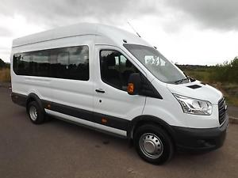
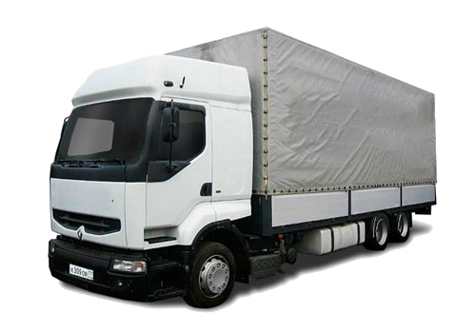
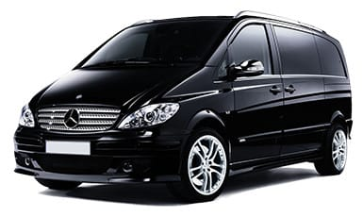
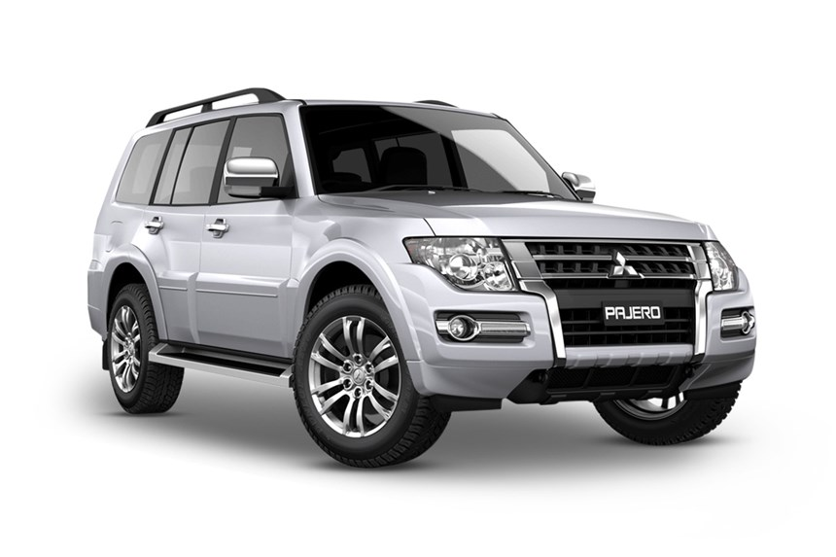
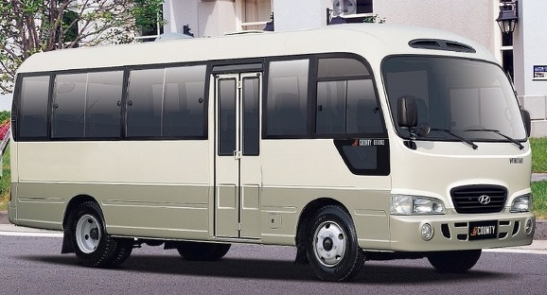
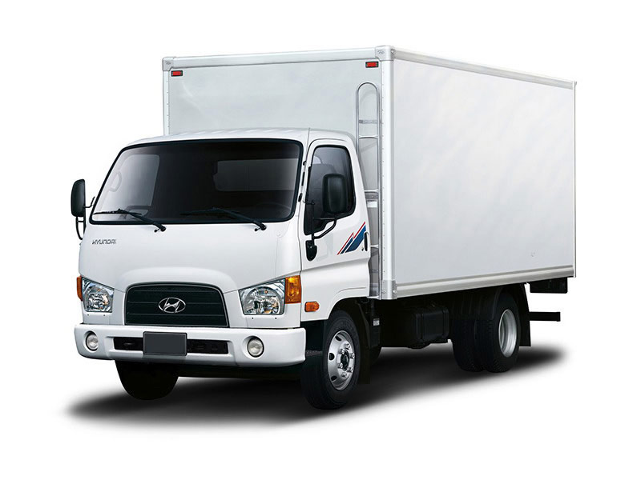
Vehicle fleet
Our fleet is comprised of trucks, buses, minibuses and cars. The models of Qala Express vehicles are mainly Toyota, Mitsubishi, Hyundai, Ford, Mercedes, and MAN. All vehicles are covered with compulsory third party liability and comprehensive insurance

Slide 7
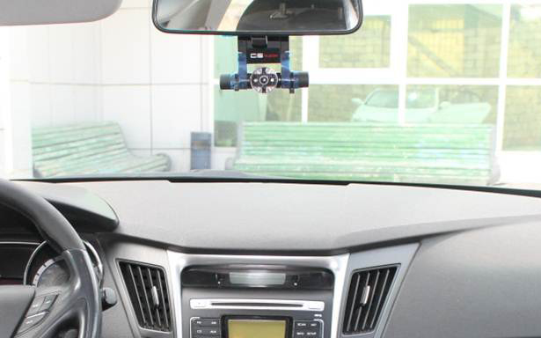
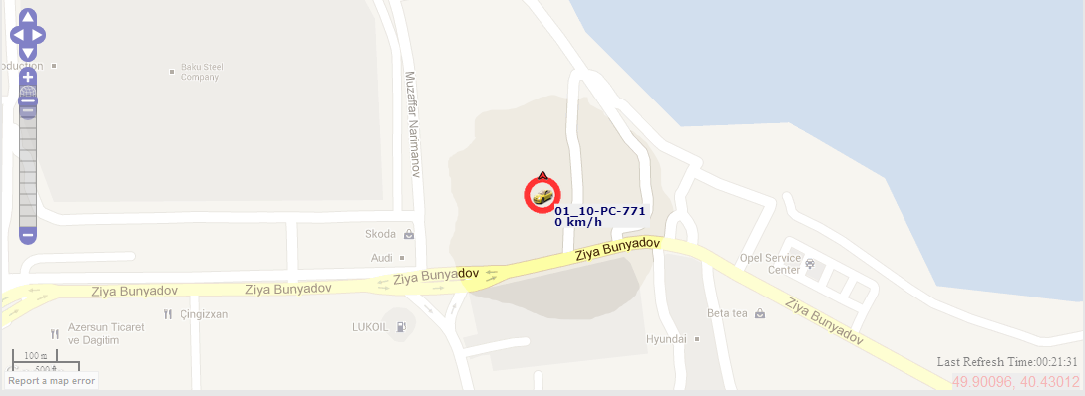
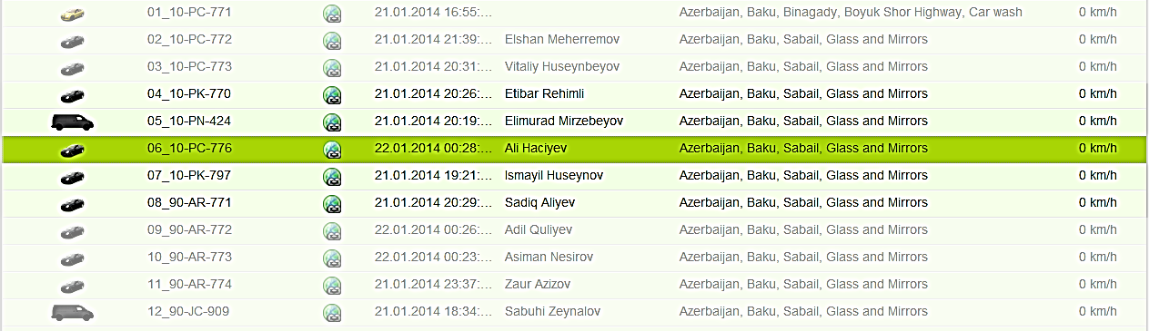
Vehicle safety
All vehicles are equipped with safety kits, emergency and first aid kits
In-vehicle data recorders such as GPS tracking system and video cameras with both inside and outside view are installed in every business vehicle. These are impeccable assets in fleet control and management including driving behaviors

Slide 8
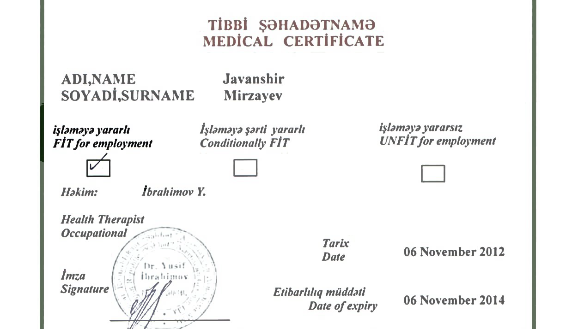
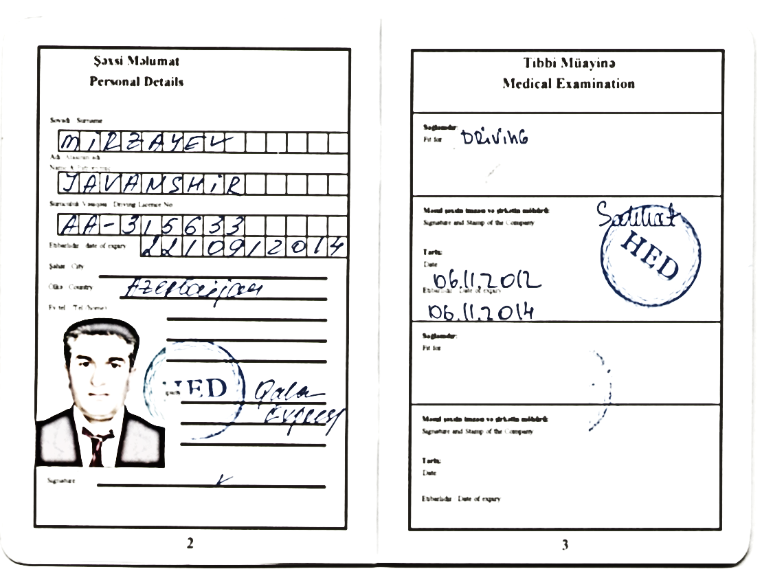
Driver competency
All our Drivers are trained and have Driver permit. Drivers pass pre-employment and annual medical checkups. Moreover, Driver staff participates in regular Safe Driving trainings

Slide 9












Our Clientele
Our credo – don’t be part of the problem, be part of the solution

